Slide 1
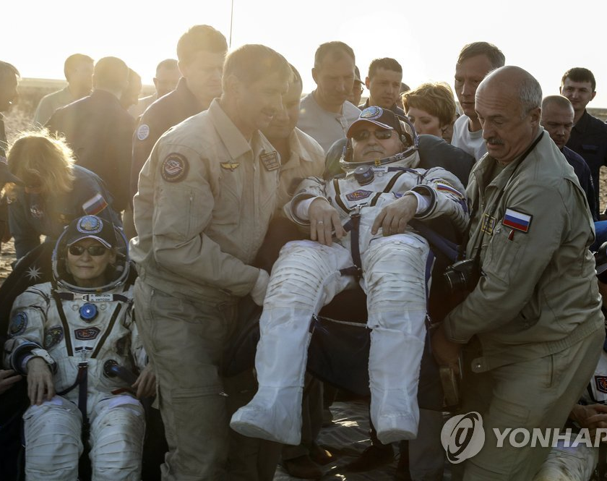

Da Cosmos Guardians
Enhancing Astronaut Well-being in Microgravity: A Breath-Controlled Health Solution

Slide 2
Team Member
Multi-disciplinary background with communication skills and creative ideas for better human life in space journeys.
박승재
Seungjae Park
Data Wizards
Yonsei University
Graduate School of Engineering
Computer Software
고한나 정우성
Hanna KO
Woo-Sung Jung
Tech Gurus
Bio-Hacker
Yonsei University
Graduate School of Engineering Computer Software
Yonsei University
Graduate School of Biomedical Engineering
Physical Therapy
We are more than just experts;
we are innovators with a shared vision : to enhance human well-being during space missions
김지예 전선민
Jiye Kim aka Eunice
Sunmin Jeon
Space Designer
Code Wizards
Yonsei University
Graduate School of Engineering
Computer Software
Yonsei University
Graduate School of Engineering
Computer Software

Slide 3
Enhancing Spacefarers' Well-being in Microgravity through Innovative Recreation
The Challenge
In prolonged microgravity environments, astronauts face profound physical and mental challenges:
Physical Issues
Musculoskeletal Changes: Loss of bone density and muscle mass.
Cardiovascular and Fluid Shifts: Alterations in circulation and body fluid distribution.
Respiratory System and Pulmonary Function Changes : Impact on breathing and lung efficiency.
Mental Issues
Isolation and Loneliness: Astronauts can experience psychological stress from prolonged isolation.
Our Approach
Breathing-Based Game :
Using data from Earth's breathing patterns as a baseline to maintain optimal breathing rates in space.
Objective: To ensure astronauts maintain proper breathing rates while engaging in a fun, challenging activity that helps improve both their mental and physical well-being.
Mechanics: NASA celestial data, such as sunspot explosion patterns, will dictate the rhythm and difficulty levels in the game.
Outcome:
Physical Fitness: By controlling breathing, astronauts can enhance respiratory health and pulmonary muscle strength.
Mental Well-being: The game helps reduce stress, combat isolation, and provides a stimulating form of relaxation, offering fun while easing tension and promoting relaxation.

Slide 4
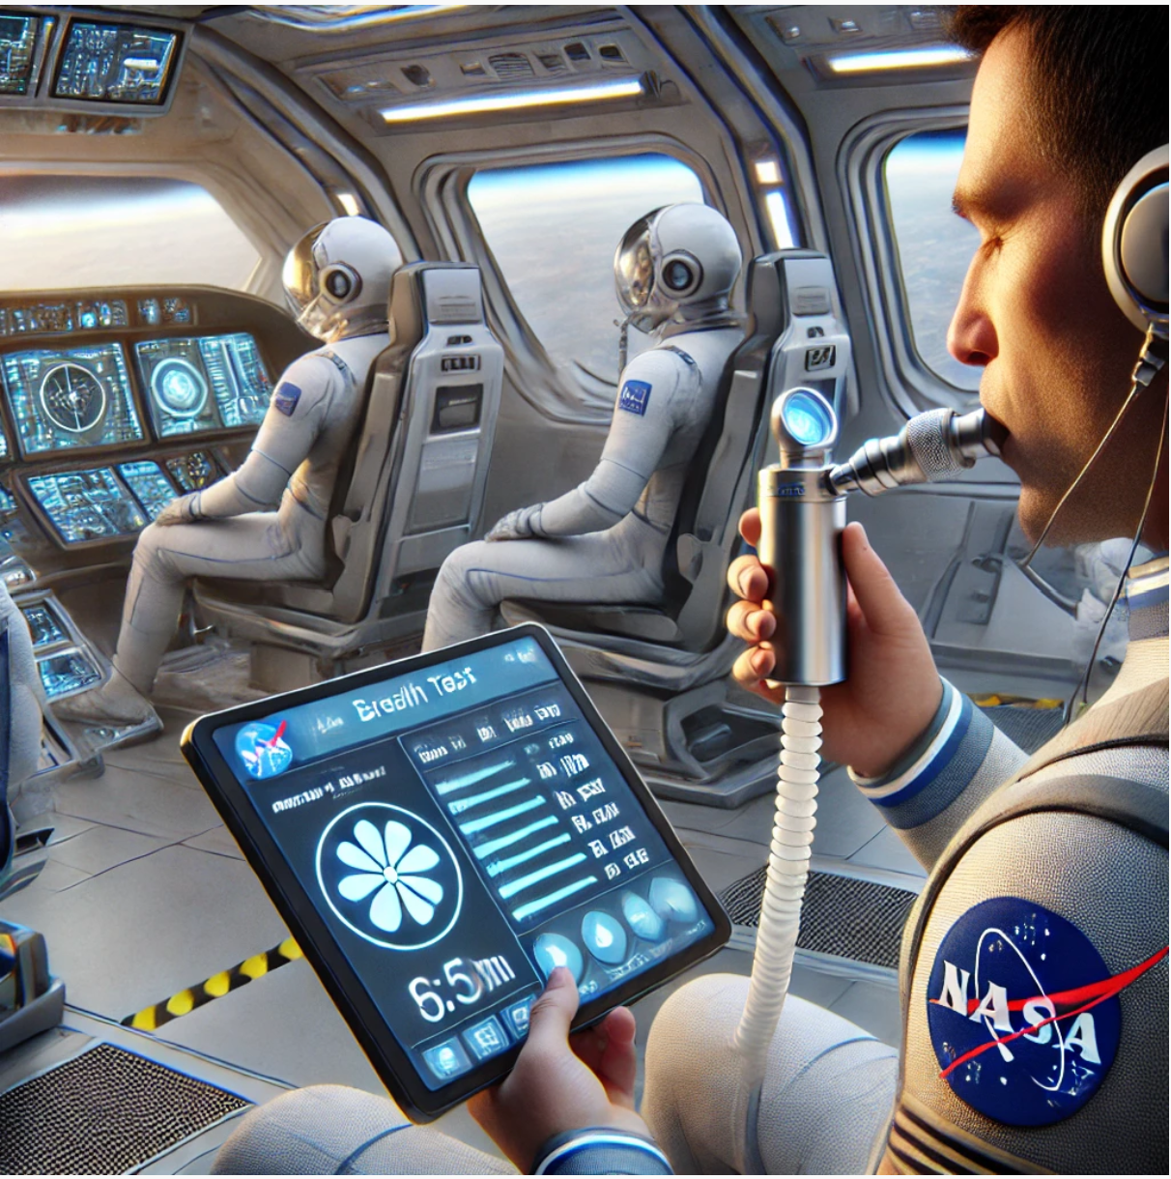
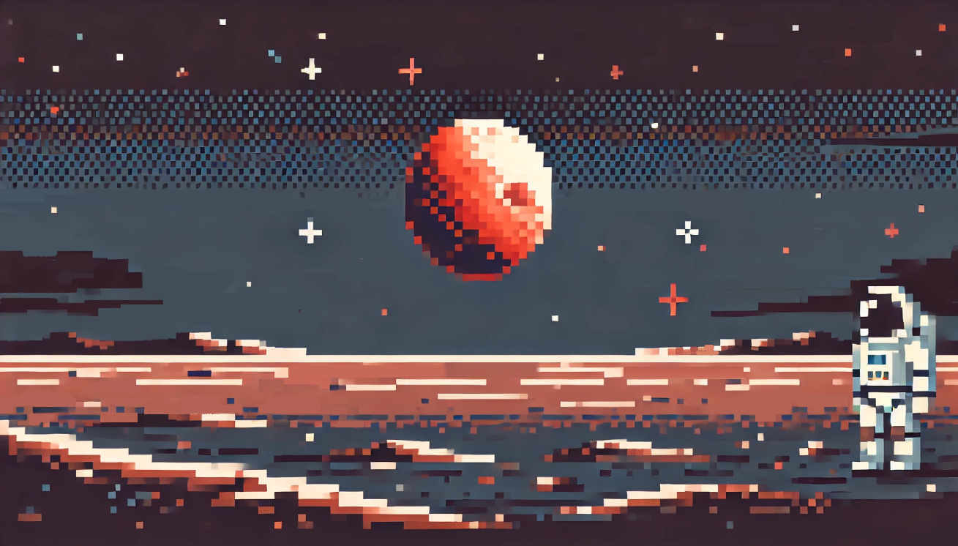
Breathing-Controlled Game
A breathing-controlled platformer where players use their breath as the primary input to control character actions (e.g., movement, jumping, hopping). The game's difficulty and actions are influenced by real-time physiological data and adapted to space’s unique conditions. With IoT integration capturing data like MIP, MEP, and MVV, Cosmic Respire establishes an innovative feedback loop between the player's breathing and the in-game environment
How it works :
IoT Integration: Breathing patterns are captured via an IoT device and transmitted to the game.
Gameplay: Players navigate levels similar to classic platformers like Mario, but every action is controlled by their breathing technique.

Slide 5
How We Use Data From NASA
Aligning Respiratory-Muscle date for Spaceflight
Sun Touches Everything into Game’s Fun Factor
Alpha Data: Earth-based respiratory metrics simulate optimal breathing conditions.
α ( earth gravity ) Respiratory Muscle Strength
= a (MEP) x b (MIP) x C (MVV) + d
Solar Wind : Real-time data (density, speed, temperature) is dynamically integrated into the game, shaping the flow and positioning of in-game elements, with rewards such as the Helios Coins being influenced by these parameters
MIP (Max. Inspiratory Pressure ): Inhalation strength.
MEP (Max. Expiratory Pressure ): Exhalation strength, abdominal muscle engagement.
MVV (Maximal Voluntary Ventilation, breathing pattern, length) : Endurance and breathing pattern efficiency.
Real-Time Solar Wind Data
https://www.swpc.noaa.gov/products/real-time-solar-wind
Period Index of /products/solar-wind
https://services.swpc.noaa.gov/products/solar-wind/
Substituting α with β using the Following Data
1) GSE156321 Toward countering muscle and bone loss with spaceflight: GSK3 as a potential target (Lumbar Spine, HLS, DXA Scanning)
2) GSE93838 Spaceflight effects on human vascular smooth muscle cell phenotype and function
3) GSE159952 Gene expression data related to muscle and skeletal changes, and various physiological change data in a microgravity environment
Astronauts ID and Level
Space Crew’s Meta data : With Gender and Age and Space Flight Duration, the optimal β value will be correlated. As the duration increases, the game's difficulty increases because the β value decreases over longer durations.
α
(Earth)
Beta Data: NASA-derived metrics simulate breathing under microgravity, adjusting game challenges accordingly.
β (Microgravity) Respiratory Muscle Strength
= x (MEP) x y (MIP) x x (MVV) + Σ
P
β’
expected outcome
of our game
β
(Space)
T
GLI (Global Lung Function Initiative)
Content : Respiratory function data (e.g., FEV1, FVC) based on age (30–33 years), gender, and gravitational condition.

Slide 6
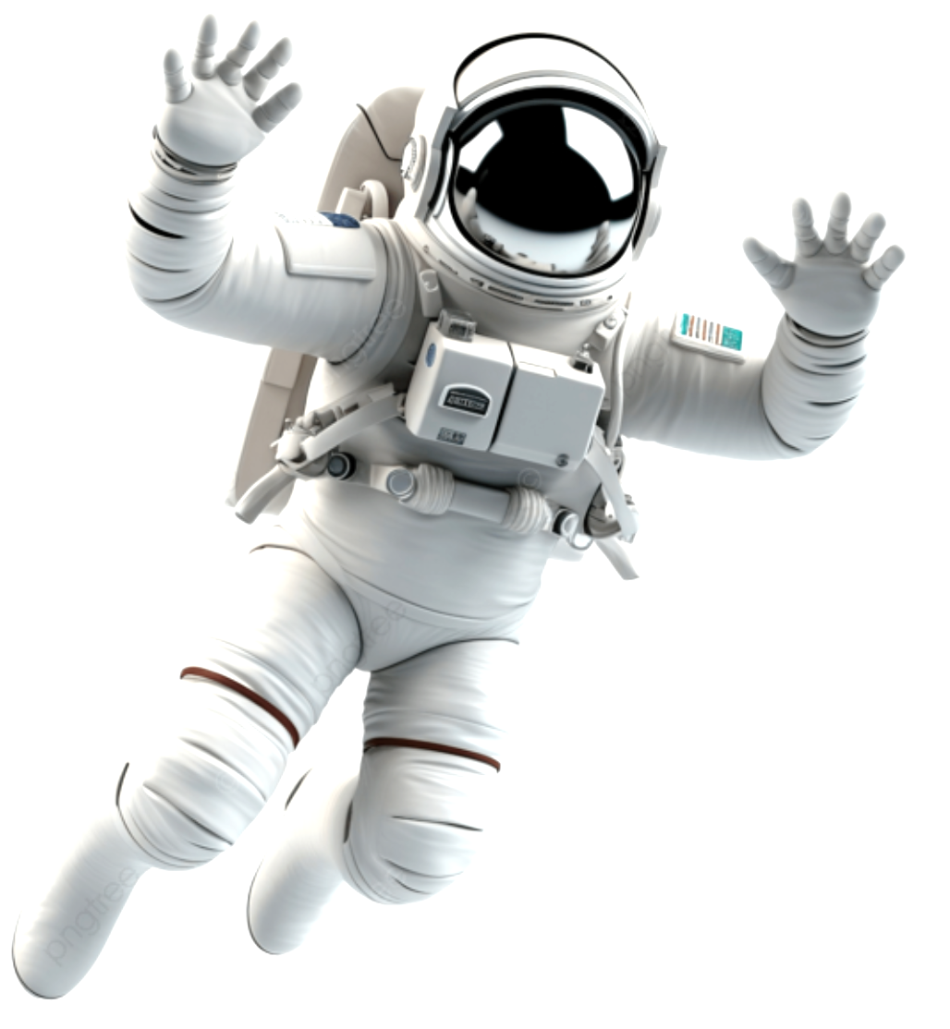
Cosmic Respire
How to play - The game character moves based on the player's breathing technique ( inhale and exhale )
Mode 1 : Hop Over Obstacle
Inhale
Inhale
exhale
Physician-Designed Programs
Stay within the optimum β range
exhale
Breathing time ( Pattern Duration )
Mode 2 : Winner Rings the Golden Sun Bell
Solar Wind As Reward : Helios Coins
Real-Time
Dynamic Patten

Slide 7
Demo Page & Info : Cosmic Respire
AI Assistant List
Chat GPT 4o : Code Validation , Game Background and item image generation
photo2pixel : Game image generation
Other Resource List
“Comparative Evaluation of Pressure Sensor Performance for Concurrent Assessment of Pulmonary Muscle Strength and Respiratory Patterns” by Woo-Sung Jung1, Ye-Jin Hong1, Jun-Young Kim1, and Yong-Heum Lee1* Department of Biomedical Engineering, Yonsei University, Wonju, Korea1 *koaim@yonsei.ac.kr
Update Note
** The executed version of code, from α to β (slide5),
uses Deep Learning algorithm and focused on MEP and MIP value.

